Slide 1
Analysis on Cincinnati housing data
Saurav Nandi, Reshma Punukollu, Pavan Motagi

Slide 2
AGENDA
Meet the Team
Primary Goal of the project
Data Analysis in R
Data Analysis in Python
Visualizing with Tableau
Conclusion

Slide 3
Meet the team
Saurav Nandi – Responsible for analysis in R
Reshma Punukollu – Responsible for analysis in Python
Pavan Motagi – Responsible for analysis in Tableau
All – Responsible equally for the presentation and the report

Slide 4
Primary Goal of the project
To analyze the housing data gathered for Cincinnati, which is the third largest city in Ohio with a population count of 309,317 as per the Census of 2020.
To gain insight into the purchasing trends and preferences and further help people moving into the city to choose their house.

Slide 5
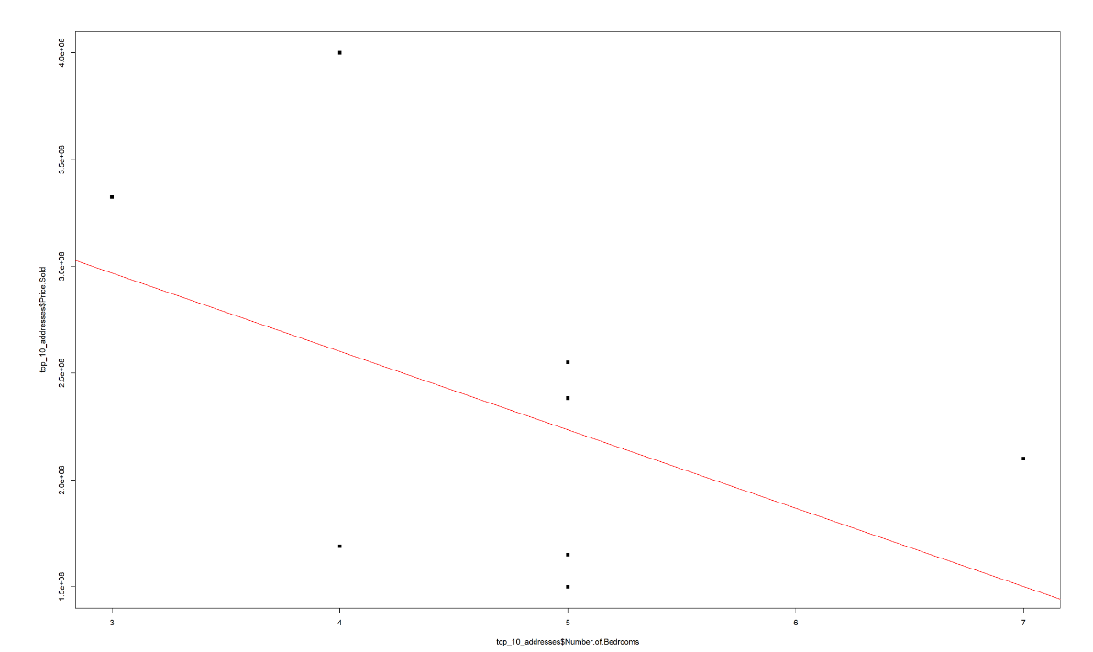
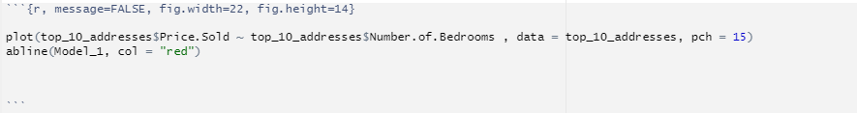
Data analysis with r
We performed linear regression analysis by choosing the price as the dependent variable and number of bedrooms as the independent variable, respectively.
Slope of the predicted value of price is negative slope .

Slide 6
PREDICTED VALUES OF PRICE OF BEDROOMS
We have also predicted the values of bedrooms in the housing provided on the basis of number of bedrooms as input using the code: predict(Model_1, newdata = data.frame(Number.of.Bedrooms= c(5, 4)))
We have used the predict function in r studio by fitting our linear regression model as mentioned in the previous slide and predicted the price values of number of bedrooms, which are 4 and 5 respectively.
Thus, the predicted price according to the principle of linear regression analysis above are 223474094 dollars and 260179275 Dollars respectively.

Slide 7
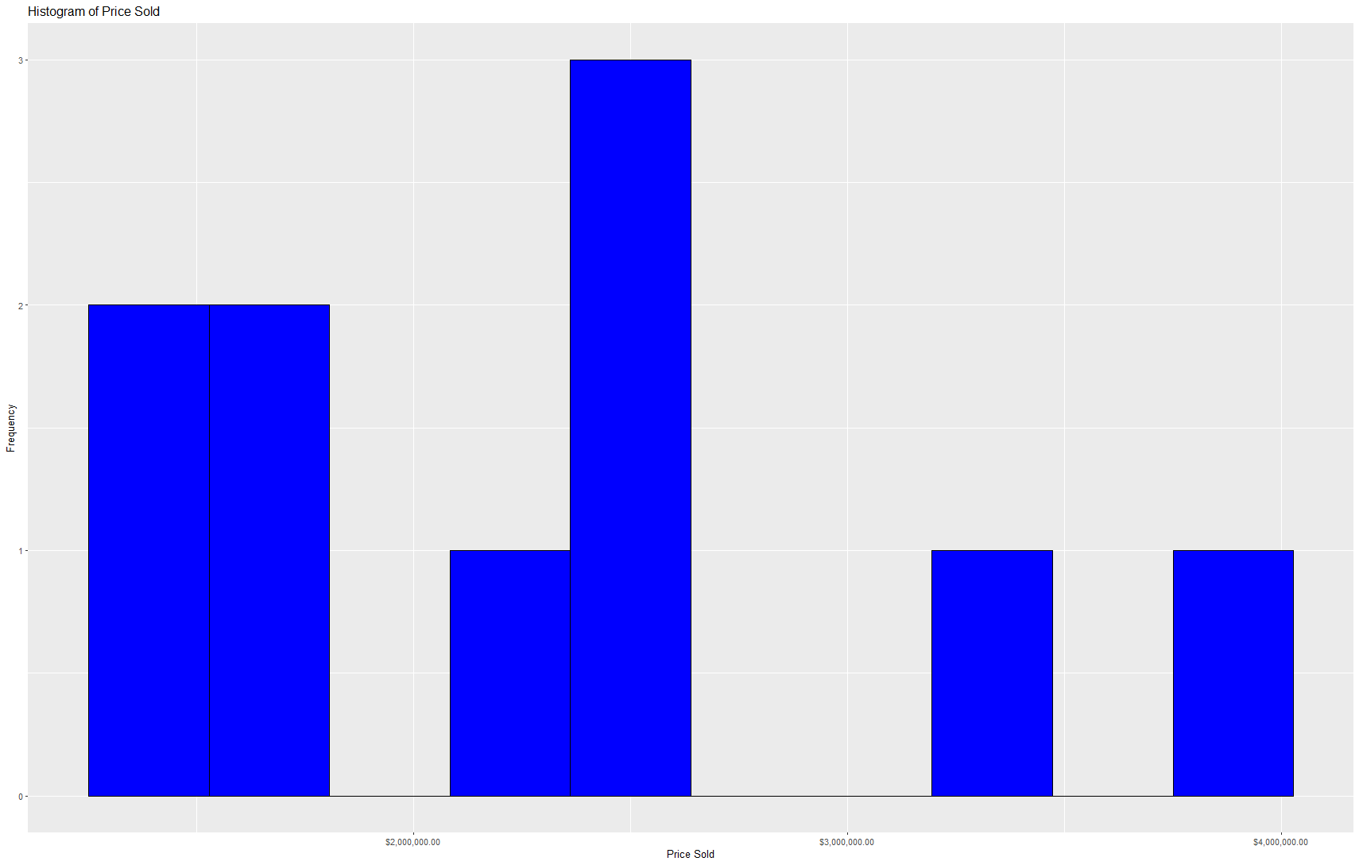
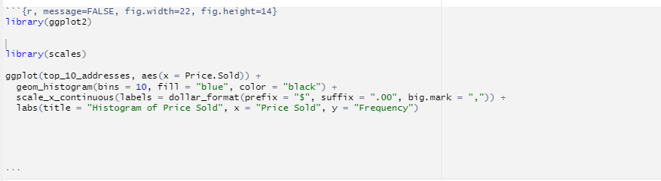
HISTOGRAM ANALYSIS OF ESTATES SOLD PER PRICES
We performed a histogram analysis of estates sold per different prices using the code:
The frequency of real estate's sold in the price between 2 Million Dollars and 3 Million Dollars is the highest, which means that real estate sellers or mortgagers should set the prize greater than 2 Million Dollars and less than 3 Million Dollars.

Slide 8
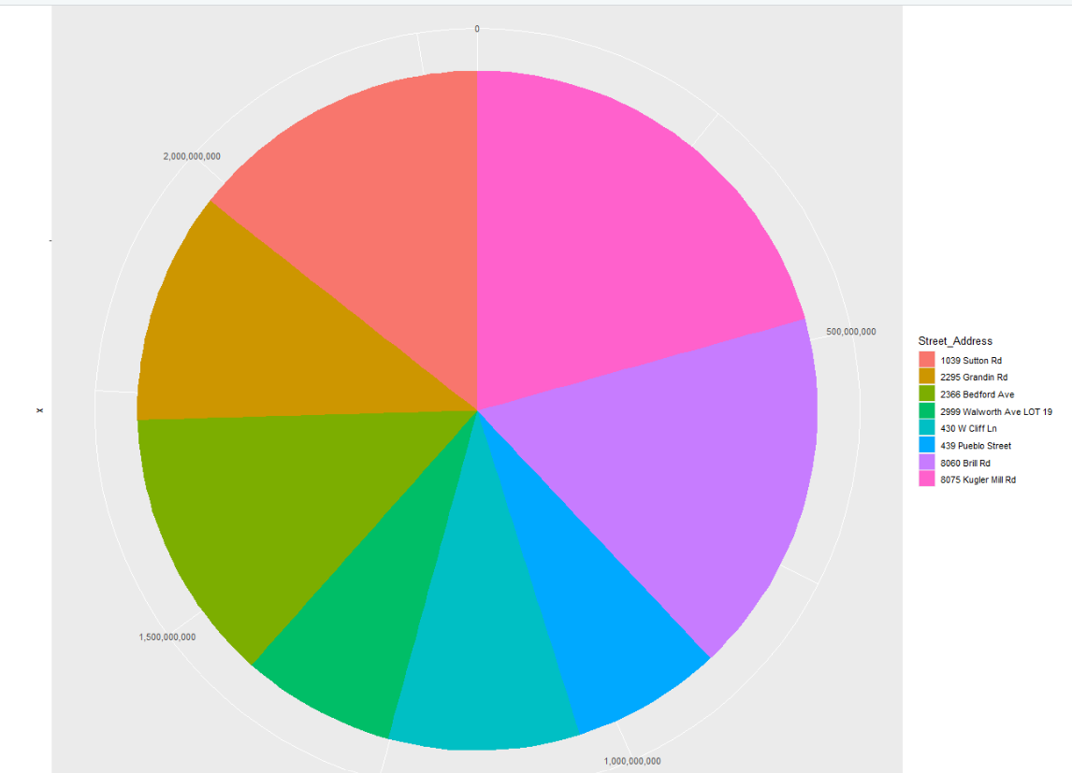
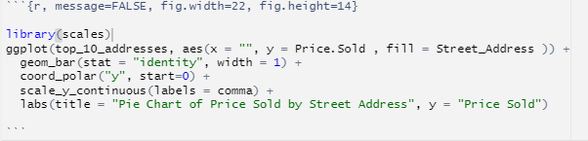
PIE CHART ANALYSIS
Finally, we have performed a pie chart analysis, where we have showcased the prices of top 10 real estate's belonging to different regions of Ohio, as shown in the figure on the right.

Slide 9
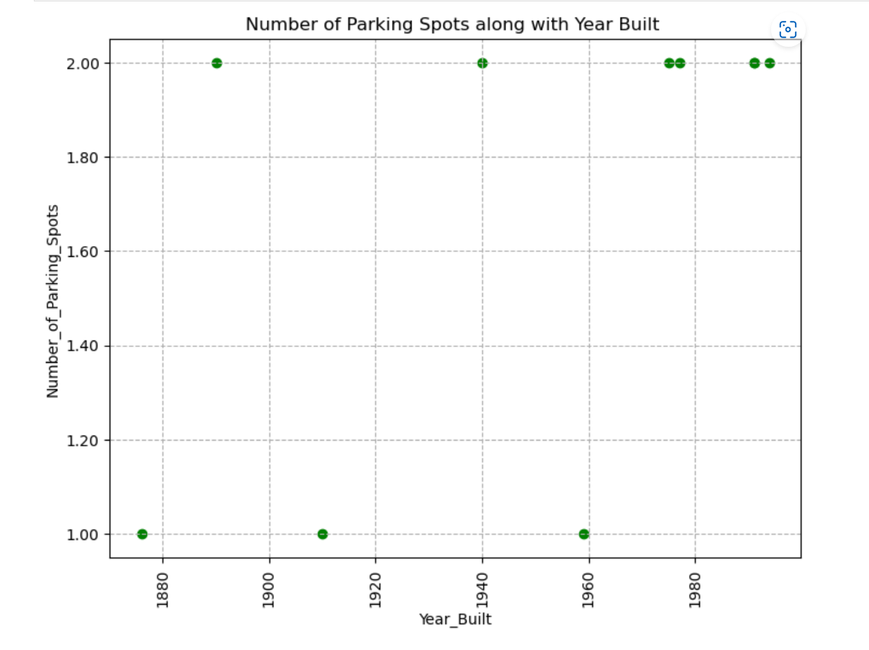
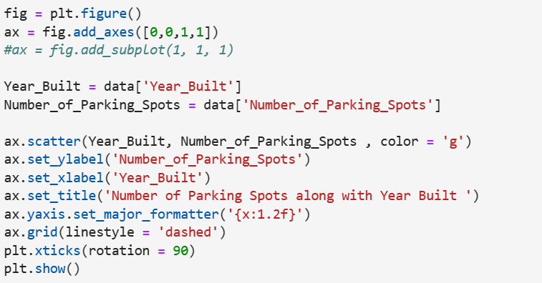
Data analysis with python
Plot for Number of Parking Spots with corresponding year
By plotting the trend of parking spots built in a year, you were able to see the number of parking lots allocated for each house each year. This visualization could be useful for understanding how the demand for parking spaces has changed over time in the Cincinnati area, as well as identifying any trends or patterns that may exist in the data.

Slide 10
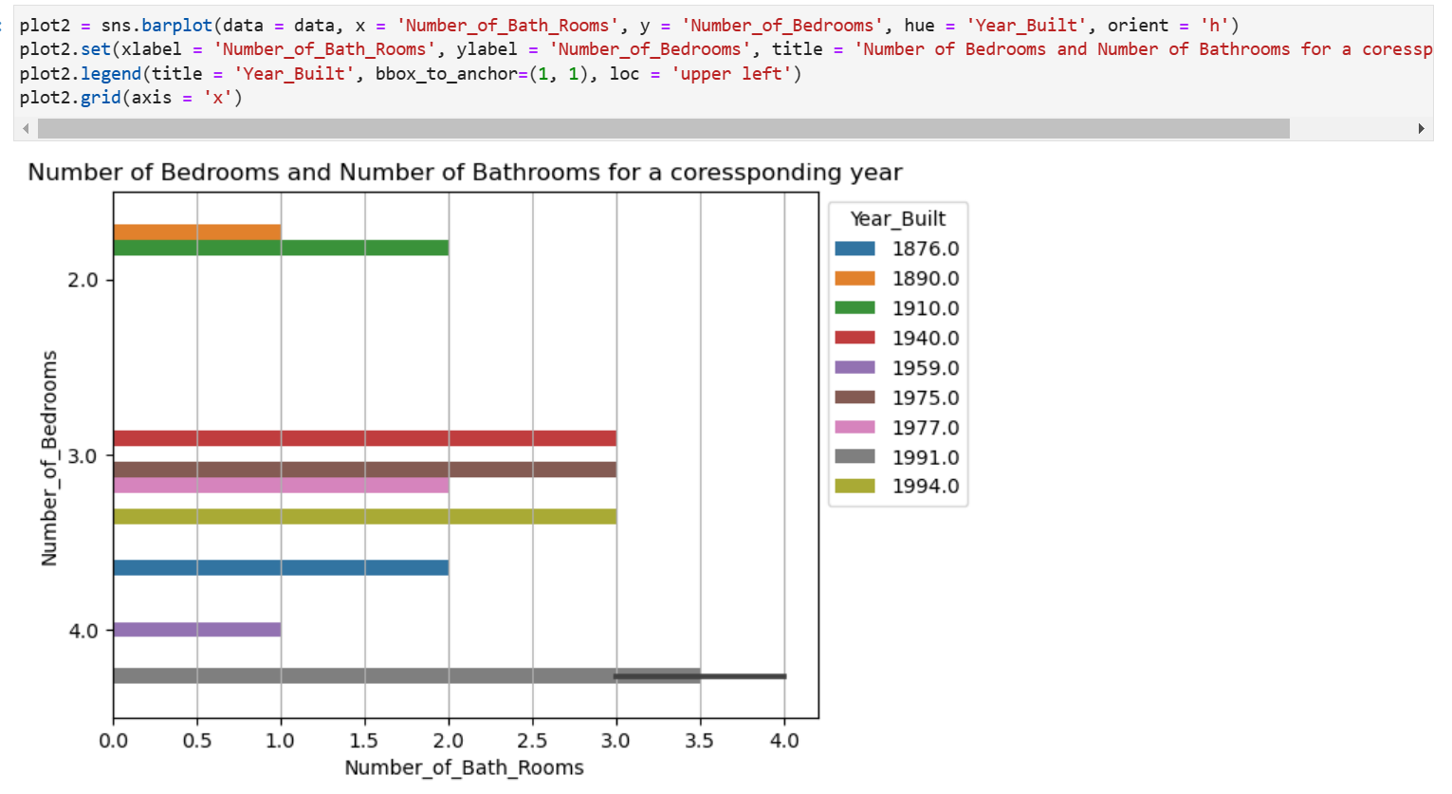
Data analysis with python
Plot for Number of Bathrooms for Bedrooms with corresponding year
We conducted an analysis of the relationship between the number of bedrooms and number of bathrooms in the greater Cincinnati area for a given year, using data analytics techniques.
By plotting this relationship, we were able to identify the number of bathrooms that were built for each bedroom in the past, as well as the factors that contributed to this trend.

Slide 11
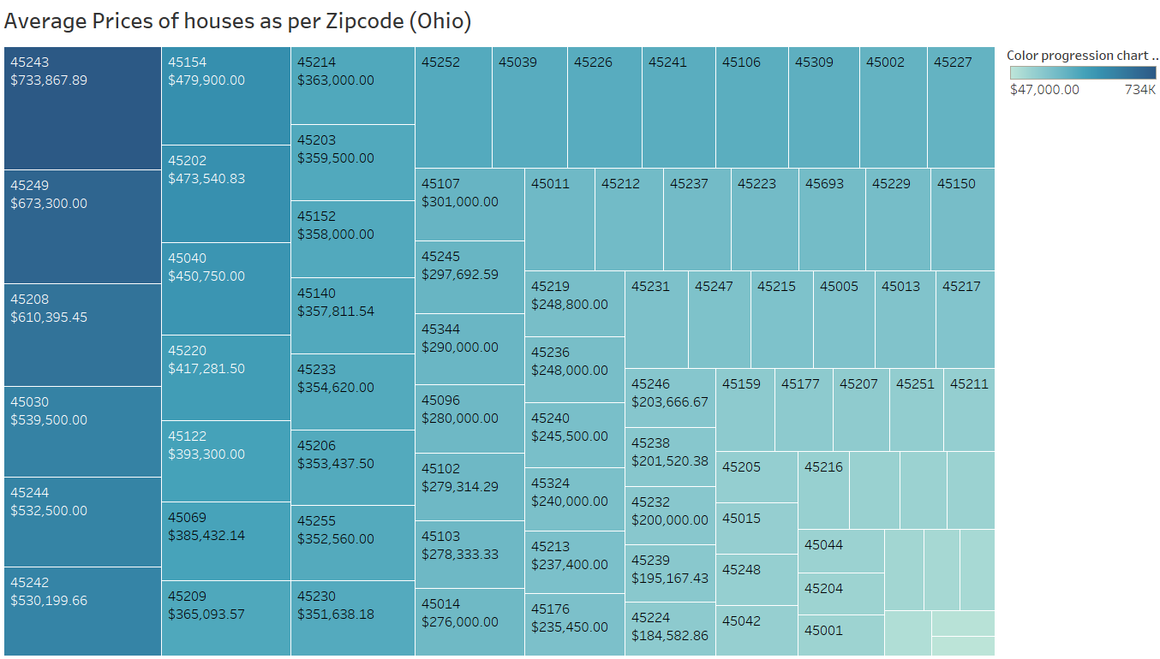
Visualizing with tableau
Analysis into the average prices of houses in Cincinnati shows us that the top 6 priciest localities are in Hamilton county – 45243, 45249, 45208, 45030, 45244, and 45242.
Since Cincinnati falls under the Hamilton county, this data proves the fact that Hamilton county is the priciest county in all the counties.

Slide 12
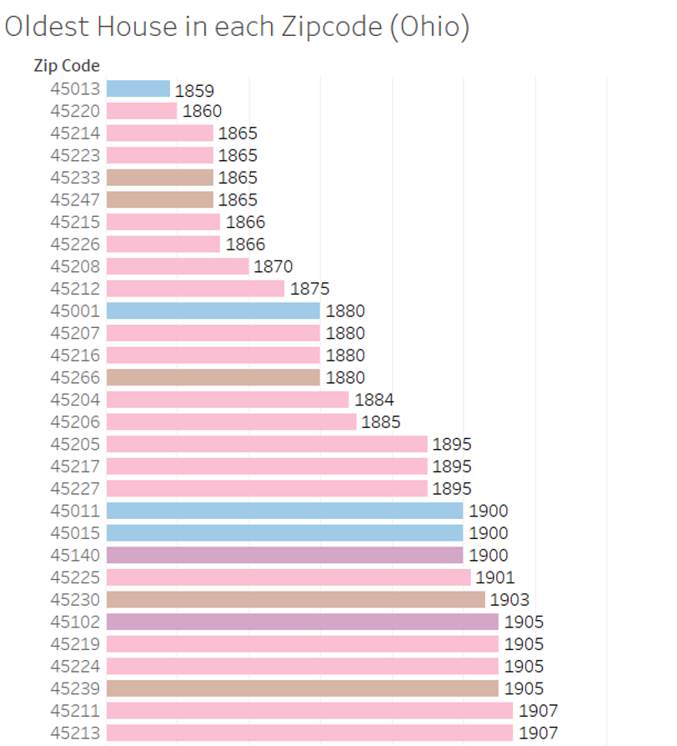
Visualizing with tableau
Analysis into the years in which various houses were built in Cincinnati grouped by their zip code shows us that the Butler county (45013) has the oldest house built in 1859.
The next 18 are in the Hamilton county – 45220, 45214, 45223, 45247, 45215, 45226, 45208, 45212, 45001, 45207, 45216, 45266, 45204, 45206, 45205, 45217, and 45227.
And the Butler county (45011) rounds out the top 20 with the 20th spot.

Slide 13
conclusion
Real estate sellers or mortgagers should set the prize greater than 2 Million Dollars and less than 3 Million Dollars respectively.
Parking lots count is more in the year 1960 compared to other years.
Houses built in greater Cincinnati area in 1991 had a greater number of bedrooms compared to others
Hamilton county is the priciest locality.

Slide 14
THANK YOU

